Slide 1
A Major Project On
Crop Yield Prediction
Guide : Mr. P. Vinay Santhosh/Mr. D. Prasad Presented By
Coordinators : Dr. G. Sai Chaitanya Kumar Batch No : C10
Mr. A. Kalyan Kumar M. Sowmya Sree (18H71A05G4)
K. Hima Soundarya (18H71A05D6)
S. Akhila (18H71A05C1)
A. Sai Samanth (18H71A05F9)

Slide 2
Problem Statement
Agriculture plays a critical role in the global economy.
Crop yield prediction is an important agricultural problem.
The Agricultural yield primarly depends on weather conditions(rain,temperature,etc).
Accurate information about history of crop yield is important.
To make decisions related to agricultural risk management and future predictions.

Slide 3
Abstract
Agriculture is the pillar of the Indian economy .
Variations in weather, climate, and other such environmental conditions have become a major risk for the healthy existence of agriculture.
Machine learning plays a significant role as it has decision support tool for Crop Yield Prediction.
It is a method to achieve a high yield of the crop using historical data.
Random Forest algorithm from machine learning can be used to solve the problem.

Slide 4
Table of Contents
INTRODUCTION
MOTIVATION PROBLEM
LITERATURE SURVEY
EXISTING SYSTEM AND ITS PROBLEMS
PROPOSED SYSTEM
UML and ARCHITECTURE DIAGRAMs
TECHNOLOGIES
And sample Source code
Output screens and REFERENCES

Slide 5
Introduction
More than 50% of India's population are dependent on agriculture for their survival.
Most of the agricultural crops are being badly affected in terms of their performance over a period of the last two decades.
Agricultural crop prediction depends on biology, climate , economy , geography.
Crop yield is central to addressing food security challenges.

Slide 6
Introduction(contd…)
So, to get rid of these problems we intended to build a model for predicting crop yield using machine learning algorithm, that is Random Forest.
The prediction made by machine learning algorithms will help the farmers to come to a decision which crop to grow to induce the most yield.
The prediction is based on analyzing a static set of historical data.
The Application which we developed, runs the algorithm and shows the list of crops suitable for entered data with predicted yield value.

Slide 7
Motivation Problem
Healthy Existence of agriculture
World’s food Demands
Supporting farmers
Recommend the crop based on the factors

Slide 8
Literature Survey
Title and Name of the Author | Name of the journal and year | Algorithms/Technique used | Advantages | Disadvantages
Crop yield prediction using machine learning. M S Minu Sanju Dharan Christo Immanuel Deepak | SRM University of Science and Technology 2020 | Random Forest ,K Nearest Neighbor, Hadoop | The web application likewise gives a discussion to the ranchers to stock the merchandise without mediators. | KNN Algorithm Sensitive to noisy and missing data.

Slide 9
Literature Survey(contd...)
Title and Name of the Author | Name of the journal and year | Algorithms/Technique used | Advantages | Disadvantages
Agro-genius : Crop Prediction using Machine Learning Anjalie Gamage Puvipavan Palendrarajah | Sri Lanka Institute of Information Technology Oct 2019 | Multiple linear regression and ARIMA Model | Recommends crop harvesting duration. Currently cultivated crop which are updated biweekly. | Limited data is used
Title and Name of the Author
Name of the journal and year
Algorithms/Technique used
Advantages
Disadvantages

Slide 10
Literature Survey(contd...)
Title and Name of the Author | Name of the journal and year | Algorithms/Technique used | Advantages | Disadvantages
Smart Farming System Using Regression Rao and Manasa | Spinger link 2018 | Multi Variety Polynomial Regression | Simple and fast to compute | High order polynomials generate numerical issues

Slide 11
Literature Survey(contd...)
Title and Name of the Author | Name of the journal and year | Algorithms/Technique used | Advantages | Disadvantages
Deep Learning for crop yield prediction in Africa Marshall Burke Stefano Ermon | AI for Social Good Workshop, Long Beach, United States, 2019 | Deep Learning On Satellite imagery | Experiment with transfer learning and , in this data sparse setting, data from other countries can help improve prediction. | Models without any temporal features do poorly on countries like Ethiopia, where there is a trend over time not captured in the satellite data.

Slide 12
Existing System
Existing System uses Decision tree machine learning algorithm.
It help the farmers to come to a decision which crop to grow.
Decision Tree:Decision Tree is a Supervised learning technique that can be used for both classification and regression problems.
Decision tree is a tree structure classifier where, Leaf node represents the outcome

Slide 13
Problems
Large datasets are not well suited.
Accuracy is comparitively low.
Trains only one decision tree.
Overfitting can happen.

Slide 14
Proposed System
We intend to build a machine learning model with Random Forest algorithm to provide high accuracy.
Random Forest: It is a supervised learning algorithm, is based on the concept of ensemble learning, which is a process of combining multiple classifiers to solve a complex problem and to improve the performance of the model.

Slide 15
Advantages
Better Accuracy
Can work with large dataset
Multiple decision trees are trained parallelly for prediction.
Possibility of overfitting is low.

Slide 16
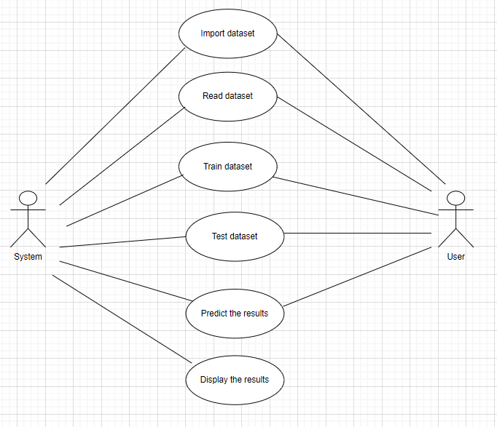
Usecase diagram

Slide 17
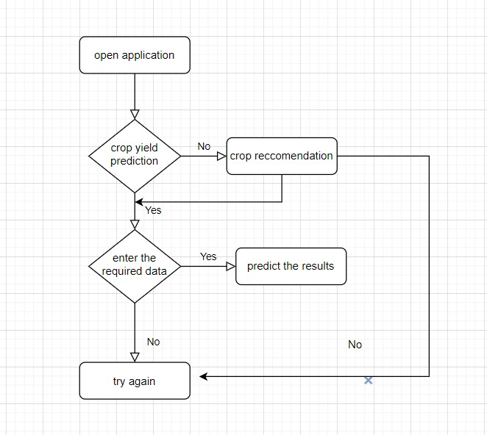
Activity diagram

Slide 18
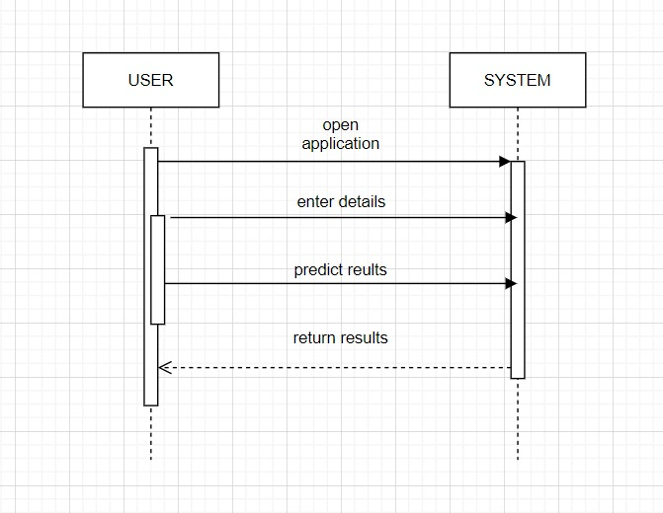
Sequence diagram

Slide 19
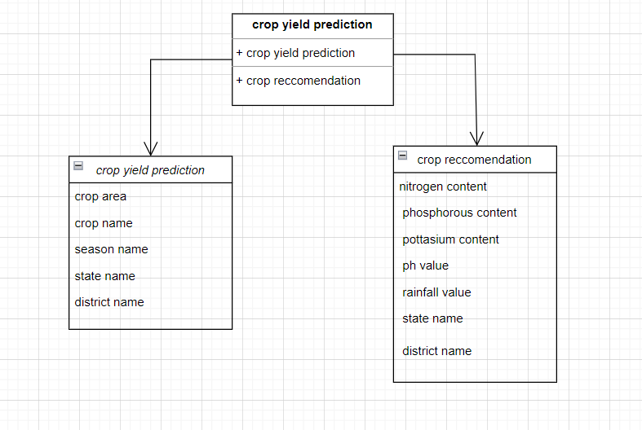
Class diagram

Slide 20
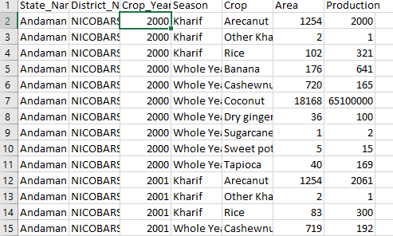
Dataset
Dataset is taken from Kaggle

Slide 21
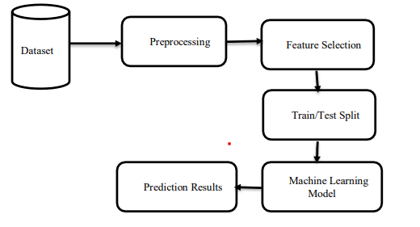
Architecture Diagram

Slide 22
Technologies
Software Requirements:
Operating System : Windows 10
Platform: Google Colab
Programming Language : Python
Framework : Flask

Slide 23
Technologies
Hardware Requirements:
Processor : I3 Onwards
RAM : 128MB
Hard disk : 8GB

Slide 24
Sample Source Code
App.py
from flask import Flask, render_template, request
import requests
import pickle
import numpy as np
import pandas as pd
import config
from sklearn.preprocessing import LabelEncoder
from sklearn.ensemble import RandomForestRegressor
from sklearn.model_selection import train_test_split
model = pickle.load(open('score.pkl', 'rb'))
app = Flask(__name__)

Slide 25
Sample Source Code
def weather_fetch(city_name):
api_key = config.weather_api_key
base_url = "http://api.openweathermap.org/data/2.5/weather?" complete_url = base_url + "appid=" + api_key + "&q=" + city_name
response = requests.get(complete_url)
x = response.json() if x["cod"] != "404":
y = x["main"] temperature = round((y["temp"] - 273.15), 2)
humidity = y["humidity"]
return temperature, humidity
else:
return None

Slide 26
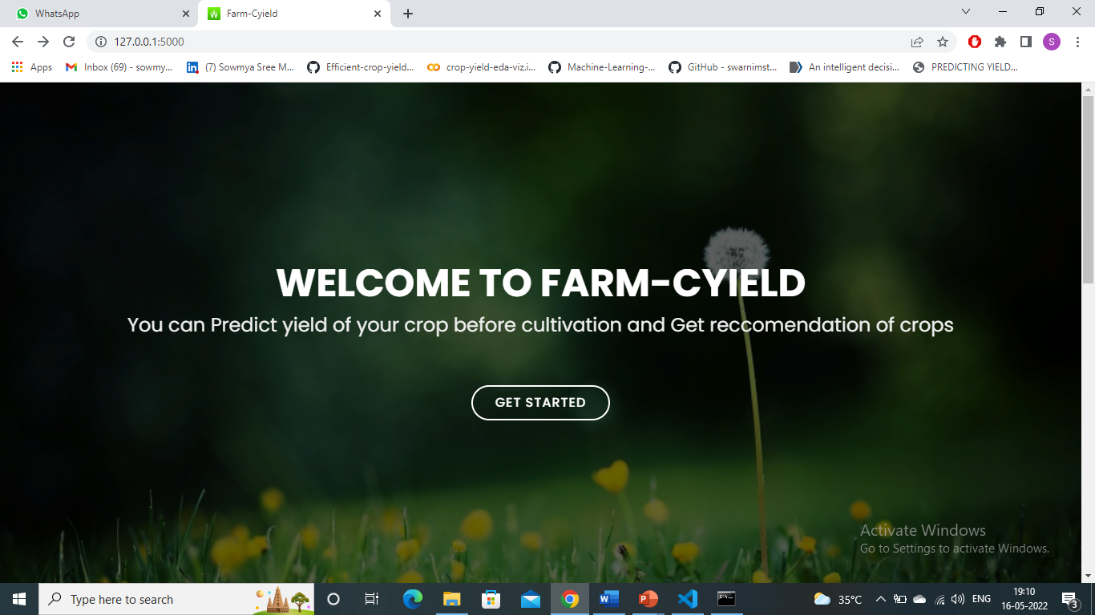
Output Screens Home Page

Slide 27
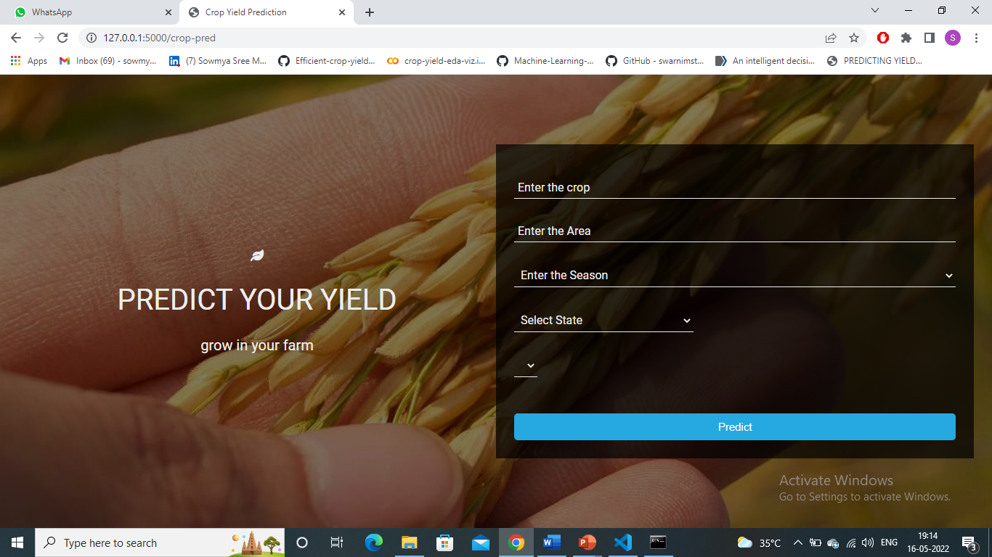
Output Screens Yield Prediction Page

Slide 28
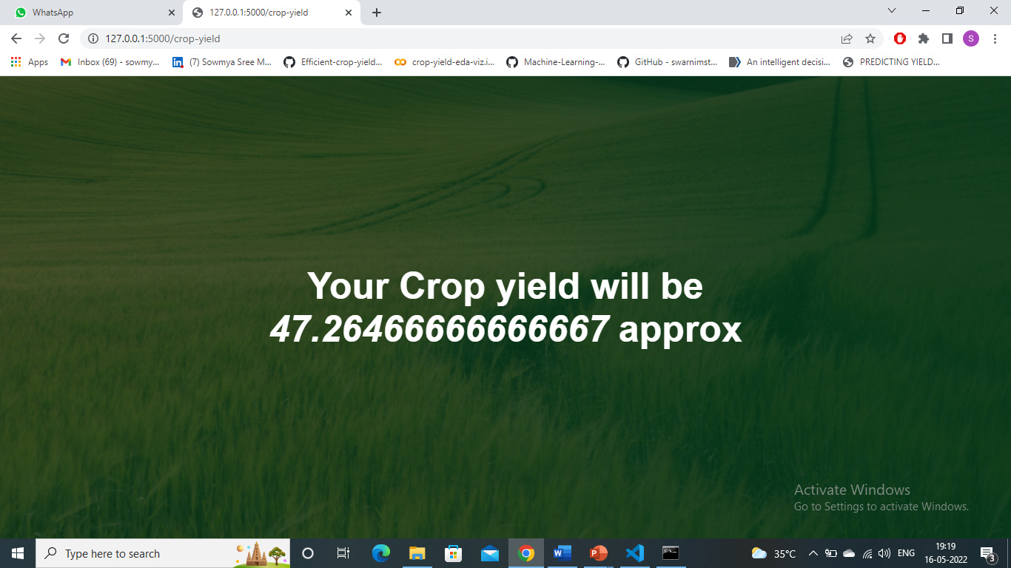
Output Screens Yield Prediction Output Page

Slide 29
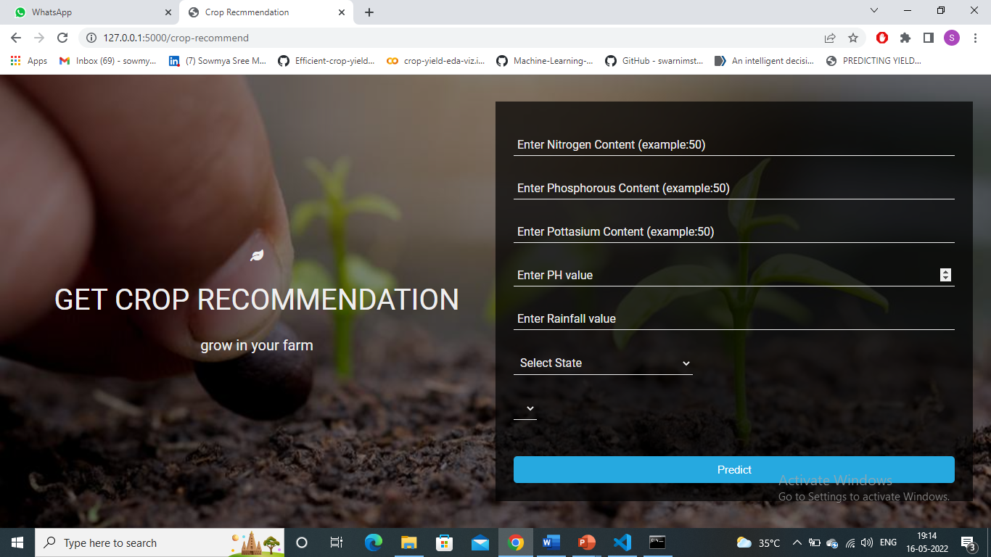
Output Screens Crop Recommendation Page

Slide 30
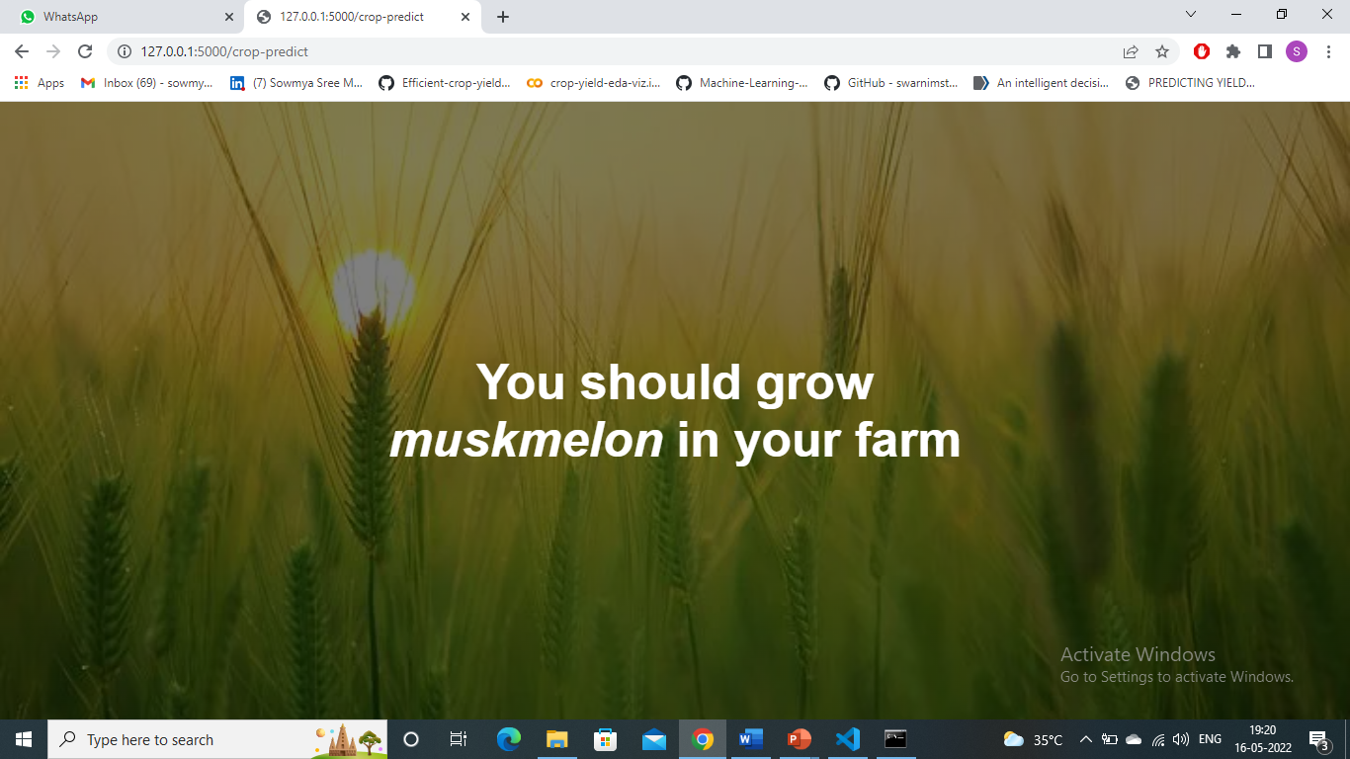
Output Screens Crop Recommendation Output Page

Slide 31
Conclusion
Nowadays farmers facing so many challenges due to variations in weather, climate, and other such environmental conditions have become a major risk for the healthy existence of agriculture.
To solve these challenges and get rid of these problems we intended to build a good model for predicting crop yield using machine learning algorithms, those are linear regression, Random Forest.
By this model we can predict the yield of a crop by considering the soil type , crop type and other factors . This can be done by previous year statistics.

Slide 32
References
Keita, N. Improving cost-effectiveness and relevance of
agricultural censuses in africa: Linking population and
agricultural censuses, 2018.
Keita, N. Improving cost-effectiveness and relevance of
agricultural censuses in africa: Linking population and
agricultural censuses. 04 2019.
Kuwata, K. and Shibasaki, R. Estimating crop yields with
deep learning and remotely sensed data. In Geoscience
and Remote Sensing Symposium (IGARSS), 2015 IEEE

Slide 33
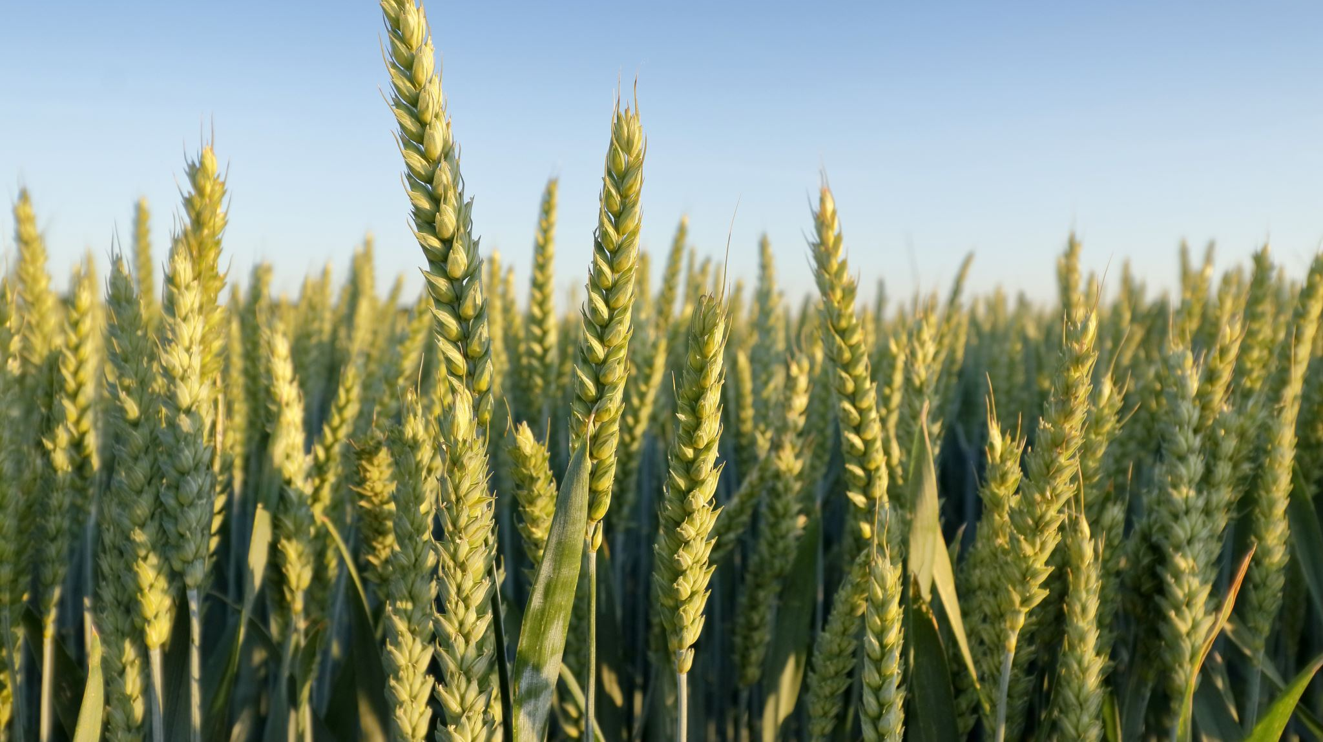
Thank You

